Slide 1
BSCS-7th Semester
M. Arham
Lecturer
The University of Faisalabad

Slide 2
Compiler Construction
Course Code: CS-411
Lecture 02

Slide 3




www.tuf.edu.pk
unioffaisalabad
Credit Hours: 3(3-0)
Theory: Cr. Hr. 03
Practical: Cr. Hr. 00

Slide 4
Content
Preprocessor
Compiler
Assembler
Interpreter
Loader and Link-editor
Translator
Type of Translators
List of Compilers

Slide 5
Preprocessor
Preprocessors are programs that process the source code before the actual compilation begins. They are not part of the compilation process but operate separately, allowing programmers to modify the code before compilation.
  The pre-processor removes all the #include directives by including the files called file inclusion and all the #define directives using macro expansion.
  For example: Let in the source program, it is written #include "Stdio. h". Pre-Processor replaces this file with its contents in the produced output.

Slide 6
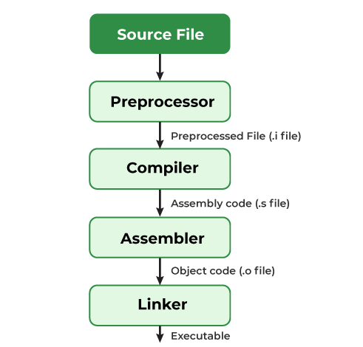
Preprocessor

Slide 7
Compiler
A compiler is software that translates or converts a program written in a high-level language (Source Language) into a low-level language (Machine Language or Assembly Language).

Slide 8
Compiler
Operations of Compilers
  These are some operations that are done by the compiler.
  Breaks source programs into smaller parts.
  Enables the creation of symbol tables and intermediate representations.
  Helps in Error Detection.
  Saves all codes and variables.
  Analyses the full program and translates it.
  Convert source code to machine code.

Slide 9
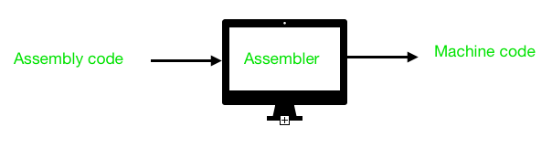
Assembler
An Assembler can be defined as a program that translates an assembly language program into a machine language program.

Slide 10
Interpreter
All high-level languages need to be converted to machine code so that the computer can understand the program after taking the required inputs. The software by which the conversion of the high-level instructions is performed line-by-line to machine-level language, other than compiler and assembler, is known as INTERPRETER.

Slide 11
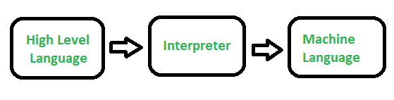
Interpreter

Slide 12
Loader and Link-editor
The basic work of a linker is to merge object codes (that have not even been connected), produced by the compiler, assembler, standard library function, and operating system resources.
The codes generated by the compiler, assembler, and linker are generally re-located by their nature, which means to say, the starting location of these codes is not determined, which means they can be anywhere in the computer memory. Thus the basic task of loaders to find/calculate the exact address of these memory locations.

Slide 13
Translator
Translator is a program that takes as input a program written in one programming language (the source language) and produces as output a program in another language (the object or target language).

Slide 14
Type of Translators
Compiler
Assembler
Pre-processor

Slide 15
List of Compilers
C/C++
Java
Python
JavaScript
Many other.....

Slide 16
www.tuf.edu.pk
unioffaisalabad
Advice…!!
Kindly read the book before and after the lecture, if some terms/ words are not covered in the lecture, if appear in exam it might not appear strange or out of course.

